Slide 1
San Francisco
9 – 13 December, 2013

Slide 2
EXCERPTS

Slide 3
AMP Activities for 2013
AmeriFlux Annual Meeting 2013 (held jointly with NACP)
Two science steering committee meetings
Agarwal led ESA 2013 workshop on “Managing and Innovating the Lifecycle of Your Data”
Ongoing communication with people at ICOS, NEON, FLUXNET. Contributing to COOPEUS.

Slide 4
AMP Activities for 2013
Signed up 14 new and returning towers to AmeriFlux Network. New site inquiries form Central and South America
Commissioned two white papers on belowground carbon and LIDAR; now in draft
Developed concept and secured funding for a new Rapid Response Flux System (thanks to ?)

Slide 5
Plans for 2014
Annual meeting—David Hollinger and Peter Curtis… (is there a third member yet?)

Slide 6
Plans for 2014
Rolling out the next FLUXNET set—Margaret Torn and Deb Agarwal
4th level data processing
BADM
Communications (Give Gilberto time to talk about process; encourage attending MS meeting Wed evening)
In the past the tower teams asked to look at data before it rolls out as public. How do they want to proceed?
Website redesign

Slide 7
QA/QC site visit experience
Who?

Slide 8
Questions? Brainstorming?
Volunteers to test redesigned site (Feb 2014)
Ideas for mobile apps

Slide 11
Outline of presentation
Announce 4 things - (1) AGU evening (in-depth discussion of processing, discussion of BADM with tutorial); (2) AmeriFlux Annual Meeting; (3) AmeriFlux Data Managers Workshop Feb 2014; (4) ????
What we have accomplished - progress
What we're about to do - plans
QA/QC site visit - recipient's viewpoint
Data
Announce Feb workshop and Wed evening Microsoft event (ACTION - make up registration form - google site)
4th level processing (ex: core sites) - Gilberto and Deb
BADM and overall communication path - Deb
Give Gilberto some time to talk about the process - back and forth,
(welcome to ask questions - encourage evening Wed at the microsoft building at Westgate Mall)
Rolling out the next flux net set - the AmeriFlux level 4.
In the past the tower teams asked to look at data before it rolls out as public. How do they want to proceed? (May elicit only 1-2 comments, but we'll have made sure to reach out)
Announce Annual Meeting: Two people volunteered to be on the AmeriFlux annual meeting - Peter C and Dave H - MST has asked them to add a junior member. They can talk about Annual Meeting
Solicit ideas for mobile apps - request volunteers for testing - is anyone using mobile apps… (Barrow as example… that was a case where it's more on running an instrument, watching live data generation)
Deb -- BADM process.
Sebastien
MST
Karis McFarlane -- Soil Carbon
Martin Beland -- LIDAR
QA/QC tech team visit. From their perspective. Where it made a positive difference.
Dario -- talk at the evening event.
Gilberto -- talk about the teaming, L4. Communication path.
Annual meeting. Get up and say something about that. Peter Curtis and Dave Hollinger. Add someone junior.
What else is going on with AmeriFlux.
Synthesis.
Announcements: annual meeting, data workshop, evening event. Registration site established by then. Ask them if ORISE doing reg site.
Sebastien say anything about drought synthesis.
L4. Walk through the sites that are done on Wednesday evening, 7 pm.

Slide 12
Announcements
Three upcoming events
Feb 12-13, 2014—Venue: Lawrence Berkeley National Laboratory
AmeriFlux Data Managers Workshop
Two-day workshop on data processing, …. Room for 30. Register: ameriflux.lbl.gov/xxx. Lodging on site available.

Slide 13
Announcements
Three upcoming events
Sunday evening/Monday 05/04-04, 2014—Venue: Bolger Center, Potomac MD
AmeriFlux Annual Meeting
More details on registration and lodging later.
Organizers are Peter Curtis and Dave Hollinger (and ?)

Slide 14
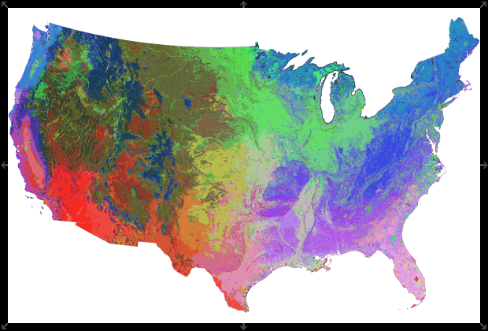
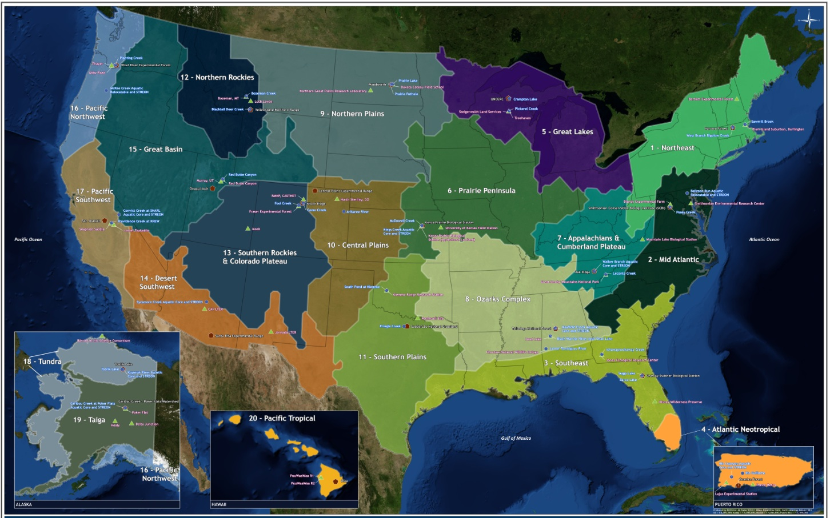
Long-term Core Sites
DOE charged the project to support 10-15 long term AmeriFlux sites
Site selection criteria:
  Existing, long term sites (ideally >10 years)
  Comprehensive set of measurements, consistently archived
  High quality data (e.g., used in many publications)
  Sites representative of important ecosystems and important ecosystem processes or changes
  Create natural gradients or experiments (clusters, sets)
  PI is both interested and willing to run a Core site.
    Expectations for data sharing, site management, and cooperation

Slide 15
Long-term Core Sites
Site selection is underway.
Due diligence and transparency. We are analyzing data records and site characteristics, progress reports, and questionnaire to site PIs.
First site selected and funds in place: Harvard Forest.
Second round of site decisions will be made in January 2013
Third round of site decisions will be made by Sept 2013
Distinguished by being long term.
Affiliate sites who follow same guidelines for
data sharing, site management, and engagement
These sites are a valuable part of the network. They do not define the network!
Notes:
Number of sites depends on costs

Slide 16
AmeriFlux Town Hall
Agenda
  Introduction (Gary Geernaert)
  AmeriFlux Highlights 2013
  AMP Highlights 2013
  Core Sites (Margaret Torn)
  Tech QA/QC (Sébastien Biraud
  Data Support (Deb Agarwal, Gilberto Pastorello
  Annual Meeting 2014 (Peter Curtis)
  White papers
    LiDAR (Martin Beland)
    Belowground Carbon (Karis McFarlane)
  Questions/brainstorming

Slide 17
AmeriFlux Town Hall
Agenda
  AmeriFlux Highlights 2013
  AMP Highlights 2013
  Core Sites
  Tech QA/QC (Sébastien Biraud
  Data Support (Deb Agarwal, Gilberto Pastorello
  White papers
    LiDAR
    Belowground Carbon (Karis McFarlane)
  Questions/brainstorming
People
  Margaret Torn
  Deb Agarwal
  Dennis Baldocchi
  Sébastien Biraud
  Gary Geernaert
  Gilberto Pastorello
  Martin Beland
  Peter Curtis

Slide 18
Long-Term Core Sites
Interviewed 15 potential long-term “Core Sites”
Selected 12 finalists for “Core Site” funding
Nine contracts either issued or in process now
The selected core site clusters represent 12 primary towers, 26 secondary towers (>25% of all active AmeriFlux sites)
AMP Technical QA/QC visited 7 core sites, and loaned instrumentation to minimize data gaps
AMP supported core site recovery from forest fire
(US-Vcm, a subalpine mixed conifer forest)
Notes:
Some contracts in progress were slowed down by the federal shutdown in October 2013.
CORE SITES: Harvard Forest(2) Howland Forest USFS(2) Konza Prairie(4) Metolius(2) Morgan Monroe State Forest(1 Mountain Air Pinyon Juniper(6) Niwot Ridge(1) N. Carolina Loblolly-Alligator River (3)Santa Rita USDA (5) Tonzi Ranch (5) UMBS (2) Willow Creek (ChEAS) (4)

Slide 19
Long term observations for
Detecting, understanding, and modeling:
Response to disturbance or management
  cumulative emissions policy and land use
Atmospheric trends
  Effects of CO₂ Fertilization
Climate Trends
  Changes in phenology
Climate Events
  Response to Droughts
Detecting & attributing changes in emissions and atmospheric concentrations

Slide 20
Long-Term Core Sites
Initial charge: fund 10-15 core sites
Progress
  Criteria from DOE
  PI questionnaire, discussion
  Data diagnostics
  Selected 13 clusters for funding
  Three sites still under discussion.
Delivering >41 sites, in 13 clusters, run by 13 teams
Name of Cluster | Number of Sites | PI’s (primary bolded)
ChEAS | 4 | Desai, Davis, Thom
Harvard Forest | 2 | Munger
Howland Forest | 3 | Hollinger
Morgan Monroe State Forest | 1 | Novick, Rahman, Phillips
New Mexico Elevation Gradient | 6 | Litvak
Niwot Ridge | 1 | Blanken, Bowling, Monson
N. Carolina Loblolly- Alligator River | 3 | Noormets
Tonzi/Vaira/Delta | 5 | Baldocchi
UMBS | 3 | Curtis, Nadelhoffer, Bohrer, Gough
Walnut Gulch/Santa Rita | 5 | Scott, Barron-Gafford
Konza Prairie* | 3 | Brunsell
Metolius* | 2 | Law
Rosemount | 3 | Griffis, Baker
Site selection criteria (DOE RFP)
PI is interested and able
Site characteristics suitable for long term
Long-term site (>10 years)
Diagnostics of current dataset, data up to date
Publication record
* In discussion
Notes:
Interviewed 15 potential long-term “Core Sites”
Selected 12 finalists for “Core Site” funding
Nine contracts either issued or in process now
The selected core site clusters represent 12 primary towers, 26 secondary towers (>25% of all active AmeriFlux sites)
AMP Technical QA/QC visited 7 core sites, and loaned instrumentation to minimize data gaps
AMP supported core site recovery from forest fire
(US-Vcm, a subalpine mixed conifer forest)

Slide 21
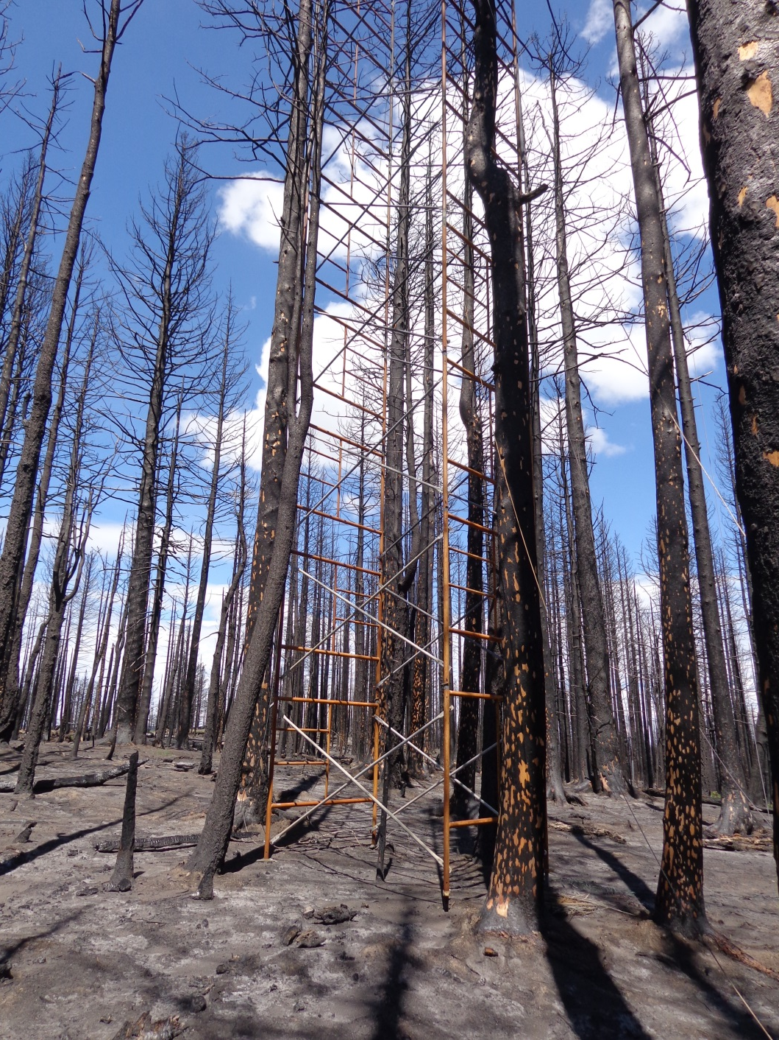
1 month post burn

Slide 22
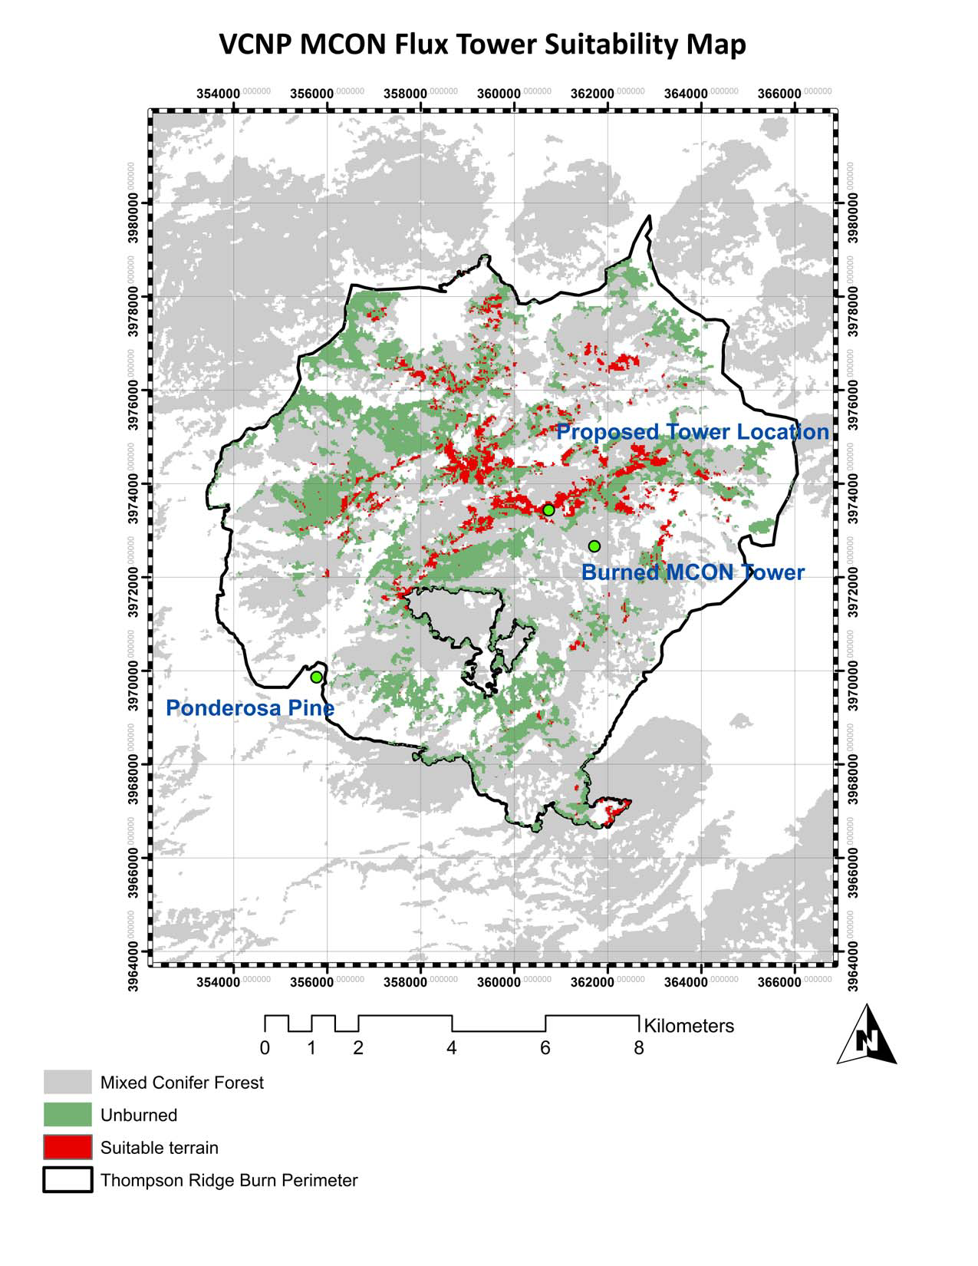

Slide 23
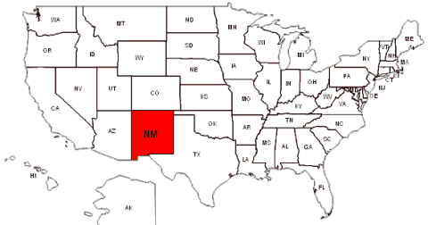
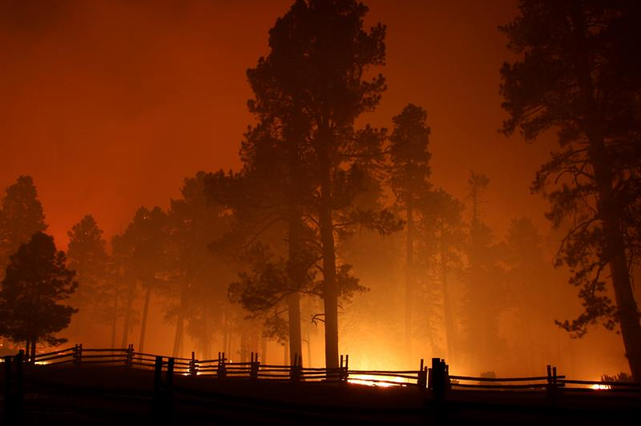
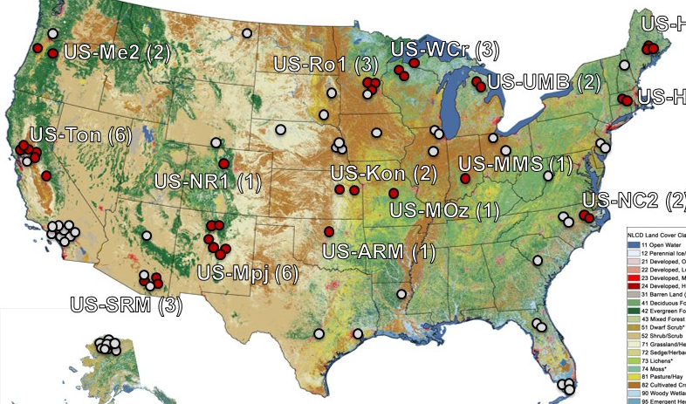
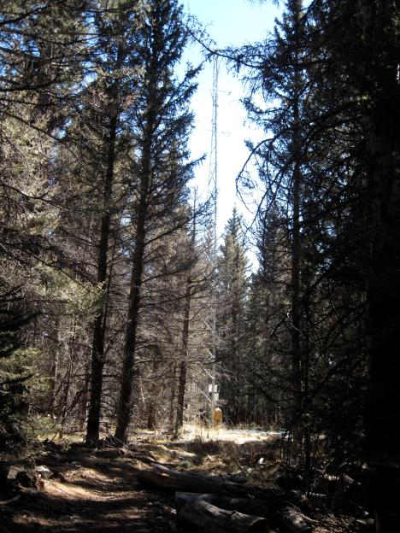
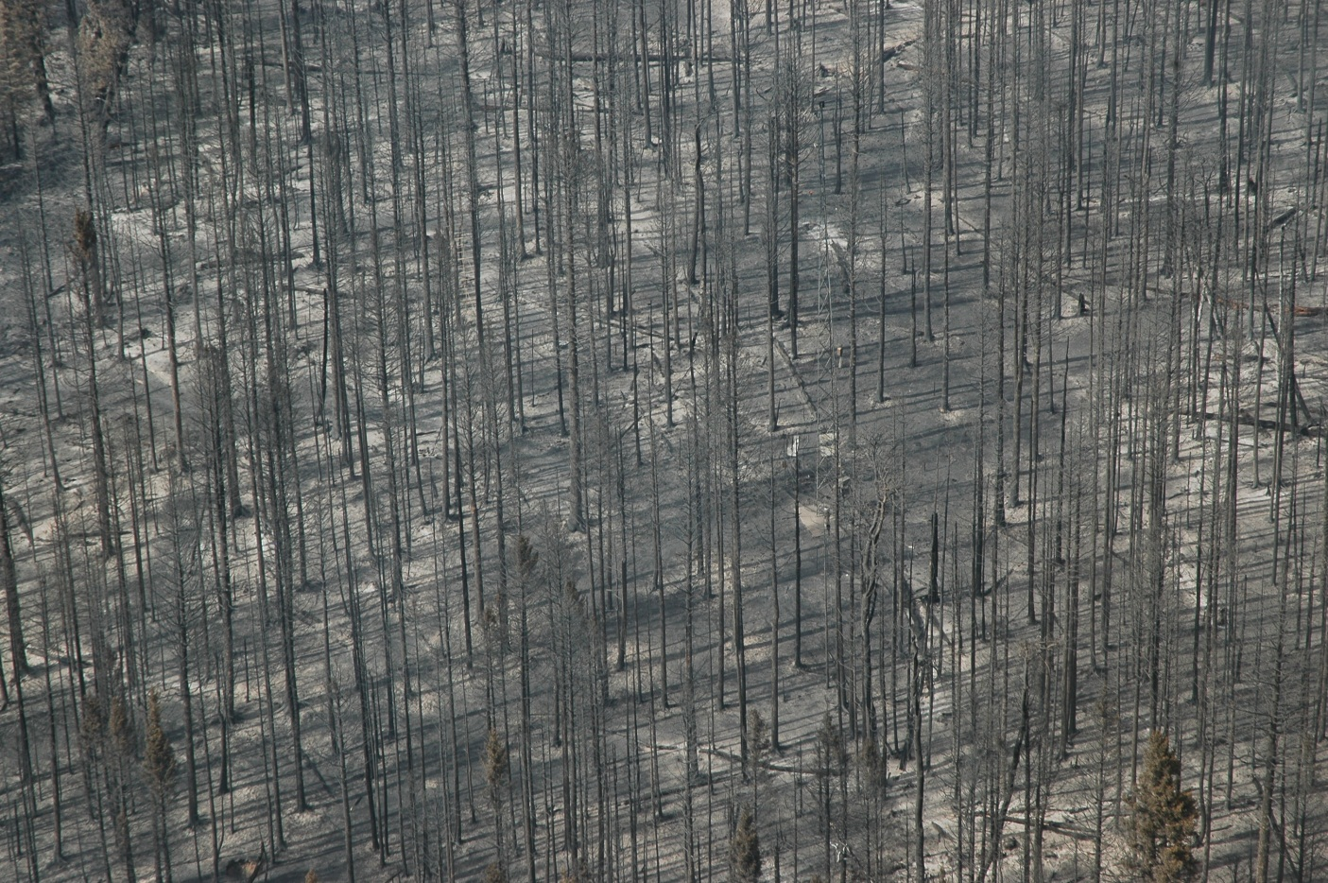
Stand-replacing fire hit the Valles Caldera Ponderosa Pine (Vcp) AmeriFlux site in June 2013
tower
The Thompson Ridge Fire devastated the Valles Caldera National Preserve (May 31-July 2, 2013), where two AmeriFlux sites are located—one in a ponderosa pine forest (US-Vcp, Valles Caldera Pondera Pine ) and the other in a subalpine mixed conifer forest (US-Vcm, Valles Caldera, Mixed Conifer), both established in 2006 (PI: Marcy Litvak, University of New Mexico).
Photos: Marcy Litvak,
Thompson Ridge Fire burned 24,000 acres in the Valles Caldera National Preserve

Slide 24
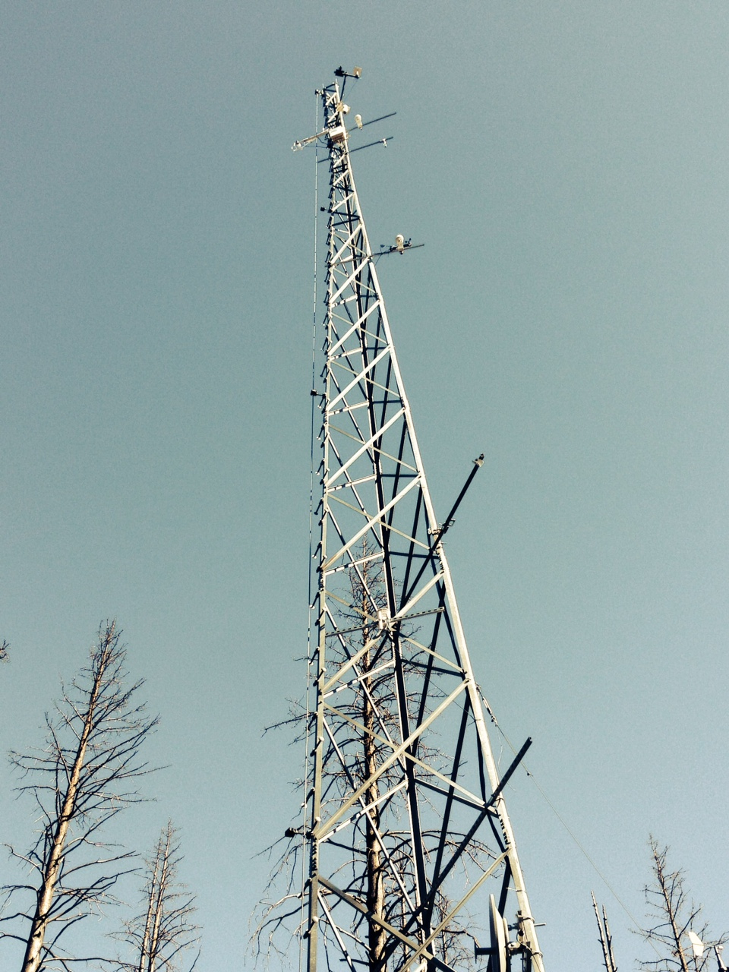
Newly instrumented tower. Functional as of October 2013.

