Slide 1
Safety Culture Improvement Program At LBNL
Presentation to DOE Operating Experience Committee on January 14, 2014
Mike Ruggieri
Chair of the LBNL Safety Culture Work Group

Slide 2

Safety is Integrated into Lab Culture
Safety Culture is based on a shared belief system where safety is integral to every part of our organization.
Safety at the Lab is not about numbers. It’s about people doing meaningful work and going home each day to their families proud about their accomplishments.

Slide 3

Safety Culture Improvement Timeline
Safety Culture Survey conducted, data analyzed, and opportunities identified (FY 2011)
Vision and Strategic Plan developed and initiatives started (FY 2012)
We are here in FY14

Slide 4
What are the Key Elements of the LBNL Safety Culture Improvement Program?
Safety Perception Survey Results: Provided a baseline that was compared to results from “Best in Class” organizations.
Work Group: Comprised of representatives from across LBNL organizations promotes and coordinates safety culture improvement initiatives.
Strategic Plan and Vision: Developed by the Work Group and approved by LBNL Senior Management. Vision was partly derived from Survey results.
Program Goals and Activities: Aligned with the vision

Slide 5
What is the Vision for Safety Culture at LBNL?
  We are all involved with safety.
  Management recognizes positive safety activities.
  Management visibly participates in safety programs and models safe behavior.
  We are all accountable for safety.
  We support each other for safety.
  Off-the-job safety is promoted.
  We are all committed to the well being of co-workers and the organization as a whole.

Slide 6
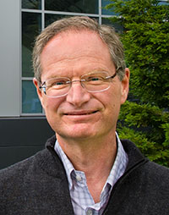

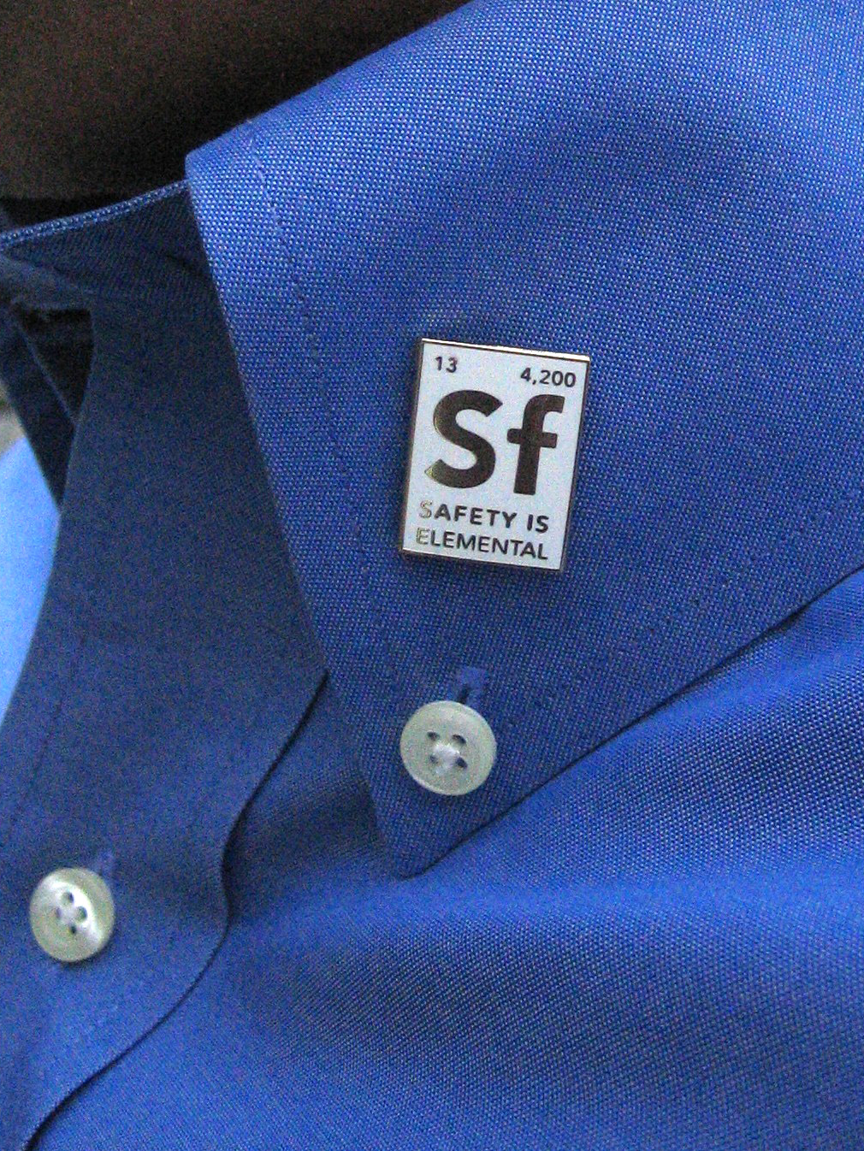
What is the Plan to Achieve the Vision?
Increase and sustain Senior Management engagement
    Support Senior Management in performing the role of SCI spokesperson to stakeholders
Develop and maintain initiatives to improve safety culture that are aligned with the Vision
  Institutional-Level
  Division-Level
Utilize Communications and Outreach
  Web Site with fresh articles, forum and resources
  “Safety Is Elemental” campaign
  Articles in LBNL daily “Today at Berkeley Lab”
  Poster campaign
  Peer-to Peer Thank You Cards
  Partnering between Divisions

Slide 7
Increase and Sustain Senior Management Engagement
“Perspectives” articles highlight LBNL Senior Managers and their views on safety in their organizations.
LBNL Deputy Director is the Executive Sponsor for the Safety Culture Improvement Program.
Poster Program includes Senior Manager activities that promote safety.
The Safety Culture Online Forum includes participation by Senior Managers.
Senior Managers award “Safety Is Elemental” pins to staff and visitors.

Slide 8
How Do Our Activities Achieve and Sustain the Vision?
 | Key Elements of the Vision for Safety Culture at LBNL
Safety Culture Work Group Activity | Worker Involvement | Management Recognition for Positive Safety | Management Commitment to Safety | Accountability | Co-Worker Support | Off-the-job Safety | Organizational Commitment
1. New Employee E-Mail | X | X | X | X |  | X | X
2. P2P Recognition Cards | X |  |  | X | X
3. Safety Culture Web Site | X | X | X | X | X | X | X
4. Poster Program | X | X | X | X | X |  | X
5. SIE Pin Program | X | X | X |  | X
6. “Perspective Series |  | X | X | X |  |  | X
7. Integrating SC into ES&H Programs and documents | X | X | X | X |  |  | X
8 TABL articles, 1 Minute 4 Safety Slides, and presentations | X | X | X | X | X | X | X
9. Strategic Plan | X | X | X | X | X | X | X
10. Safety Spot Awards¹ | X | X | X | X | X |  | X
11. Safety Concerns Program¹ | X | X | X | X |  |  | X
1. Routine LBNL Program that is not a Safety Culture Work Group Activity

Slide 9
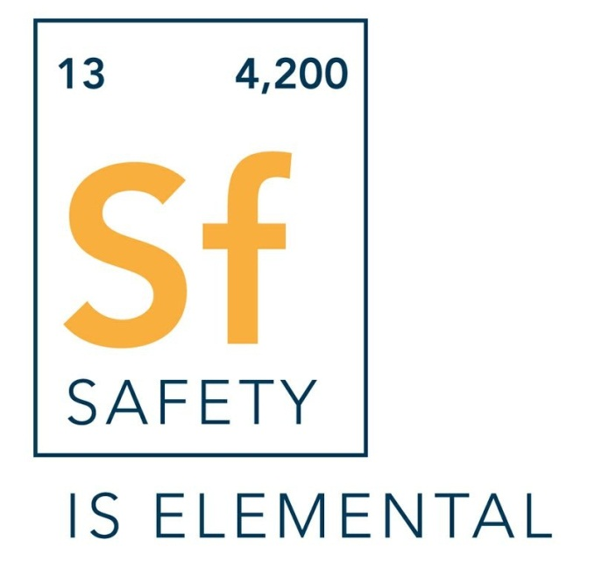
We Held a Lab-Wide Competition To Select a New Safety Phrase and Icon
Section 1: Berkeley Lab Mission
Number of
Nobel
Laureates
Number
of Staff
SUBTITLE HERE IF NECESSARY
Horst Simon with the winners of the
safety phrase competition, Liz Moxon (L)
and Lori Tamura (R) from the ALS.
9

Slide 10


We Publish Articles and Create Posters Recognizing Employee Activities That are Aligned With the Vision
Colleague’s Concern Prevents Amputation
Lab Ergonomics – It’s Not Just About the Office
It was a chance encounter on a Wednesday afternoon in late September that may have saved Xavier Permanyer’s life.
With help from EHS ergonomist Melanie Alexandre, Scientist Thorsten Weber created a new partnership to prevent ergonomics-related injuries among scientists and staffers working with the unique equipment found throughout Berkeley Lab.
10

Slide 11
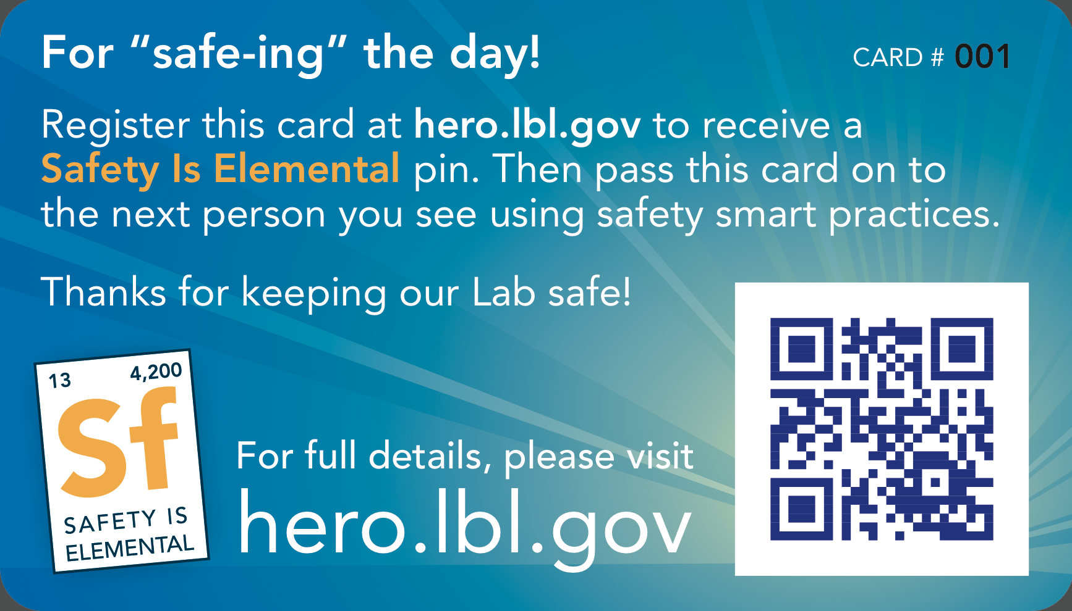

The Peer-to-Peer Thank You Card Program Recognizes Everyday Safety Activities
• Receive card for “safe-ing” the day
• Register it online
• Track it as colleagues “Pay It Forward”
Hero Cards
>100 cards exchanged since program began in
July 2013
Heroes receive “Safety Is Elemental” pin and are entered into quarterly raffle if eligible
11

Slide 12
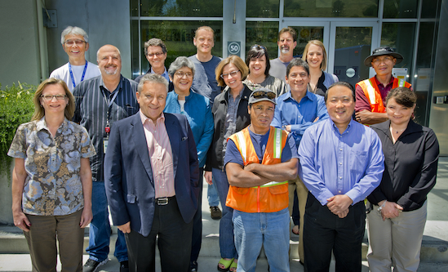
We Also Recognize Safety Performance With Prompt Spot Awards
111 Safety Spot Awards were given out in FY 2013.
  Spot Award Committee processes requests in < 1 week.
  Most monetary award values are between $25 to $150 net to staff
  Non-monetary awards are also given.
  EHS and safety staff in other divisions are not eligible for monetary award, but can receive pin and certificate.
  Most awards were presented to staff for recognizing work hazards and taking action to mitigate the hazard.

Slide 13
What Are Some of the Division-Level Initiatives?
Monitor and, as necessary, improve the communication of off-the-job safety issues.
Evaluate the effectiveness of safety leadership within lower division management levels.
Develop and fund an internal division safety recognition award program to recognize "minor" safety contributions.
Evaluate opportunities for improving Involvement of employees in safety activities.
13

Slide 14
How Are We Going to Increase and Sustain the Safety Culture Improvements?
  Obtain feedback and use metrics to evaluate the improvements.
  Revise the Strategic Plan periodically to incorporate lessons learned.
  Integrate the concepts for Safety Culture into:
    LBNL EHS documents
    EHS Technical Programs
    ESH-Related Assessments

Slide 15


