Slide 1


Safety Culture Improvement Program At LBNL
Mike Ruggieri
Program Manager
EHSS Division
Meeting with Members of the Berkeley City Council
December 11, 2012

Slide 2
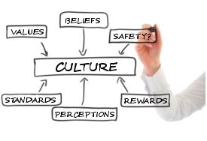
Safety is integrated into Lab Culture
Safety Culture is based on a shared belief system where safety is integral in every part of our organization.
Safety at the Lab is not about numbers. It’s about people doing meaningful work and going home each day to their families proud about their accomplishments.

Slide 3

Safety Culture Improvement Timeline
Safety Culture Survey conducted, data analyzed and opportunities identified (FY 2011)
Vision and Strategic Plan developed and initiatives started (FY 2012)
We are here

Slide 4
The Vision for LBNL Safety Culture
  We are all involved with safety.
  Management recognizes positive safety activities.
  Management visibly participates in safety programs and models safe behavior.
  We are all accountable for safety.
  We support each other for safety.
  Off-the-job safety is promoted.
  We are all committed to the well being of co-workers and the organization as a whole.

Slide 5
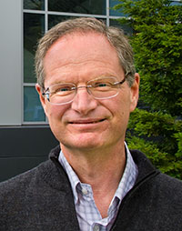

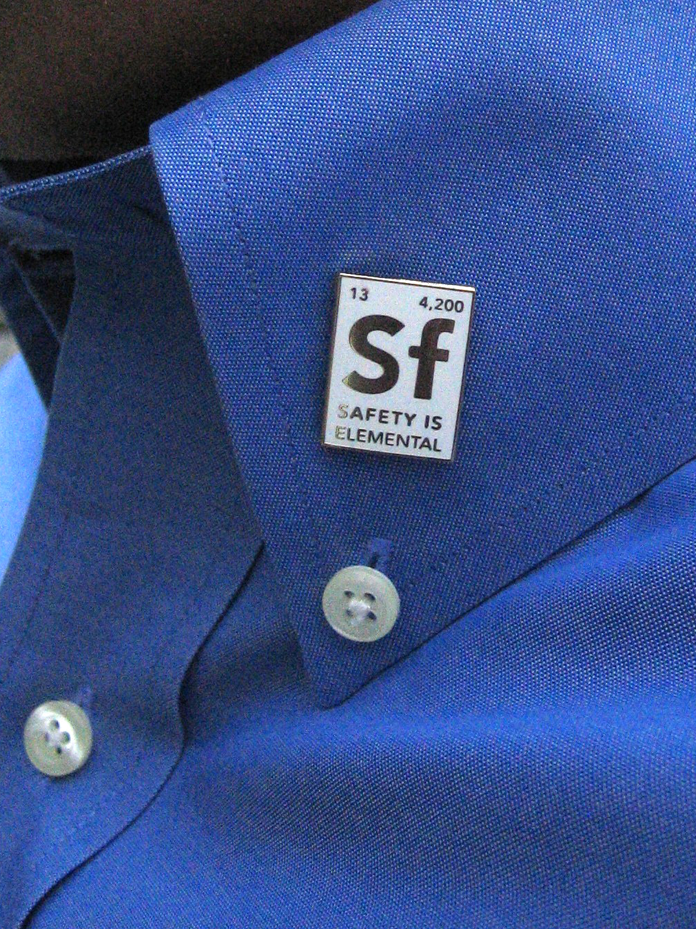
What Is the Plan to Achieve the Vision?
Increase and sustain Senior Management engagement
    Support Senior Management in performing the role of SCI spokesperson to stakeholders
Develop and maintain initiatives to improve safety culture that are aligned with the Vision
  Institutional-Level
  Division-Level
Utilize Communications and Outreach
  Web Site with fresh articles, forum and resources
  “Safety Is Elemental” campaign
  Articles in LBNL daily “Today at Berkeley Lab”
  Poster campaign
  Partnering between Divisions

Slide 6
How Are We Going to Sustain Safety Culture Improvements
  Review Strategic Plan each year and make necessary adjustments.
  Use metrics for evaluating Safety Culture improvements
  Integrate the concepts for Safety Culture into EHSS documents
  Re-Survey LBNL Staff in 2015

Slide 7


