Slide 1
Safety Culture Improvement Program At LBNL
Mike Ruggieri and Arthur Patterson
LBNL Safety Culture Work Group
Presentation to the Communications Council
April 22, 2013

Slide 2

Safety is Integrated into Lab Culture
Safety Culture is based on a shared belief system where safety is integral in every part of our organization.
Safety at the Lab is not about numbers. It’s about people doing meaningful work and going home each day to their families proud about their accomplishments.

Slide 3

Safety Culture Improvement Timeline
Safety Culture Survey conducted, data analyzed and opportunities identified (FY 2011)
Vision and Strategic Plan developed and initiatives started (FY 2012)
We are here

Slide 4
What are the Key Elements of the LBNL Safety Culture Improvement Program
Safety Perception Survey Results: Provided a baseline that was compared to results from “Best in Class” organizations.
Work Group: Comprised of representatives from across LBNL organizations; meets twice a month
Strategic Plan and Vision: Developed by the Work Group and approved by LBNL Senior Management
Program Goals and Activities: Aligned with the vision

Slide 5
The Vision for LBNL Safety Culture
  We are all involved with safety.
  Management recognizes positive safety activities.
  Management visibly participates in safety programs and models safe behavior.
  We are all accountable for safety.
  We support each other for safety.
  Off-the-job safety is promoted.
  We are all committed to the well being of co-workers and the organization as a whole.

Slide 6
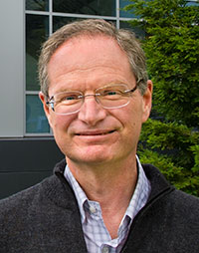

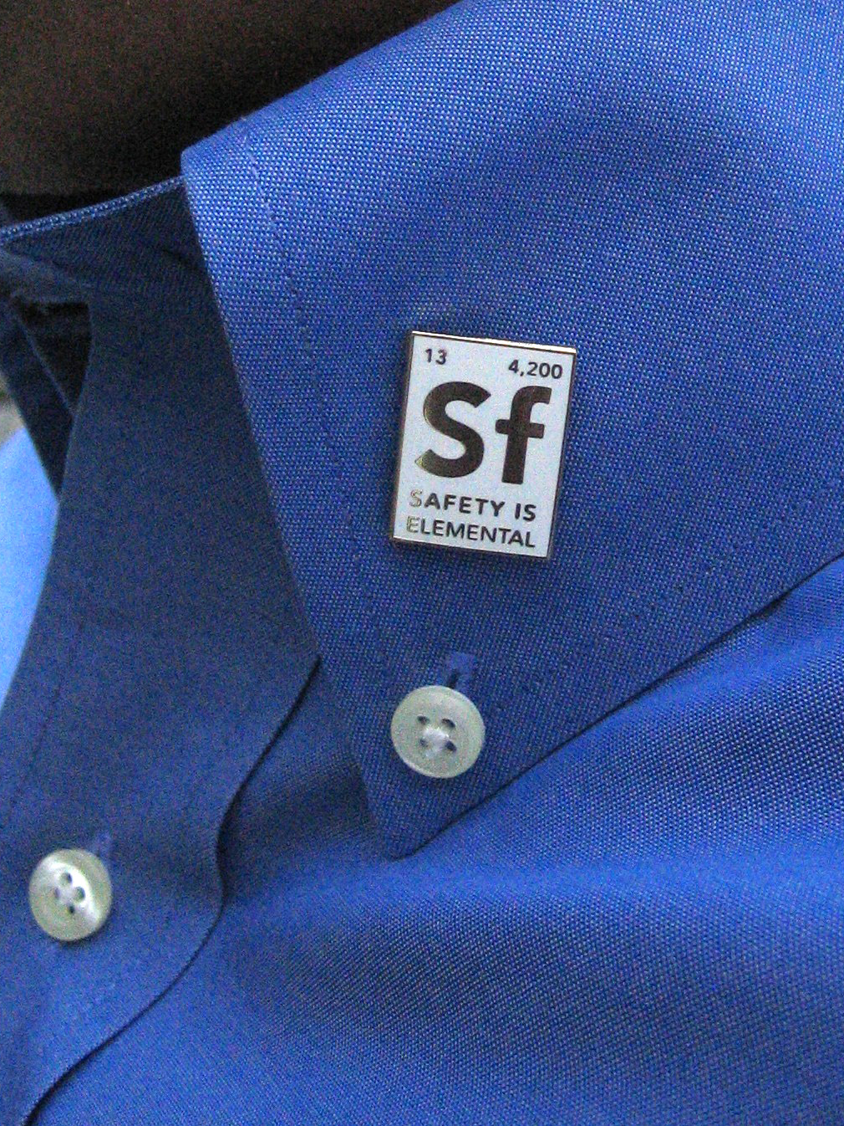
What is the Plan to Achieve the Vision?
Increase and sustain Senior Management engagement
    Support Senior Management in performing the role of SCI spokesperson to stakeholders
Develop and maintain initiatives to improve safety culture that are aligned with the Vision
  Institutional-Level
  Division-Level
Utilize Communications and Outreach
  Web Site with fresh articles, forum and resources
    Perspective series
  “Safety Is Elemental” campaign
  Articles “Today at Berkeley Lab”
  Poster campaign
  Partnering between Divisions
  Slides on the B54 cafeteria monitor
  1 Minute 4 Safety slides

Slide 7
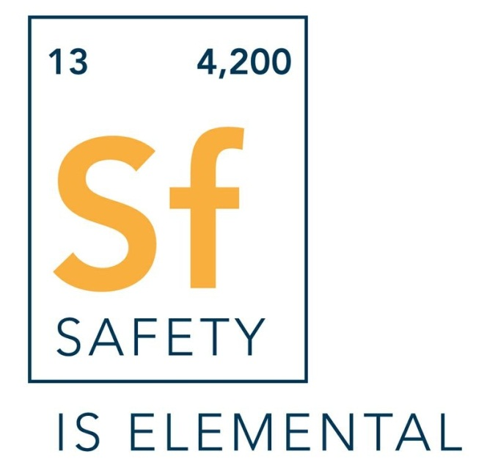
We Held a Lab-Wide Competition To Select a New Safety Phrase and Icon
Section 1: Berkeley Lab Mission
Number of
Nobel
Laureates
Number
of Staff
SUBTITLE HERE IF NECESSARY
Horst Simon with the winners of the
safety phrase competition, Liz Moxon (L)
and Lori Tamura (R) from the ALS.

Slide 8
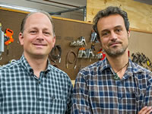

We Publish Articles Recognizing Employee Activities That are Aligned With the Vision
Colleague’s Concern Prevents Amputation
Lab Ergonomics – It’s Not Just About the Office
It was a chance encounter on a Wednesday afternoon in late September that may have saved Xavier Permanyer’s life.
With help from EHSS ergonomist Melanie Alexandre, Scientist Thorsten Weber created a new partnership to prevent ergonomics-related injuries among scientists and staffers working with the unique equipment found throughout Berkeley Lab.

Slide 9
What are Some of the Institutional Initiatives?
Safety Spot Award Program: Recognizes and rewards outstanding individual and/or team efforts.
Safety Concerns: Individuals can contact the EHSS Division by telephone or an online form for reporting safety concerns and observed hazardous conditions.
Director's Achievement Awards (Safety):Annual awards program to honor exceptional achievement by laboratory employees
Annual Safety Video Contest: Individuals or teams are invited to submit videos that addresses one or more safety, health, or environmental issue that is relevant to Berkeley Lab, either in the workplace or at home.

Slide 10
What are some of the Division Level Initiatives?
Monitor and, as necessary, improve the communication of off-the-job safety issues.
Evaluate the effectiveness of safety leadership within lower division management levels.
Develop and fund an internal division safety recognition award program to recognize "minor" safety contributions.
Evaluate opportunities for improving Involvement of employees in safety activities.

Slide 11
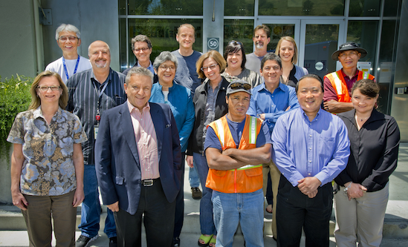
We Recognize Safety Performance With Prompt Spot Awards
80 Safety Spot Awards were given out in 2012.
  Spot Award Committee processes requests in < 1 week.
  Monetary award values are $25 to $150 net to staff
  Non-monetary awards are also given.
  EHSS staff are not eligible for monetary award.
  Most awards are for recognizing work hazards and taking action to mitigate the hazard.

Slide 12
What Are Some New Institutional Initiatives in the Works?
E-mails to new employees introducing them to the safety culture at LBNL.
Employee Recognition Cards to encourage peer to peer acknowledgment of every day safe behavior.

Slide 13
How Are We Going to Sustain Safety Culture Improvements?
  Review Strategic Plan each year and make necessary adjustments.
  Use metrics for evaluating Safety Culture improvements
  Integrate the concepts for Safety Culture into EHSS documents
  Re-survey LBNL Staff in 2015

Slide 14
How Can the Safety Culture Work Group and the Communication Council Partner?
Periodic status reports from the Work Group to the Communication Council.
Feedback from the Council on what safety culture initiatives are working well.
Partnering with the Council on Division level initiatives.
Coordinating communications to ensure that they are aligned with the vision for safety culture.

Slide 15


